Slide 1

IDENTIFY SHARES AND POLITICS TRENDS IN NEAR REAL TIME
YANIV PROTAN
ALON KENIG

Slide 2
Analyze trends helps you predict where current business operations and practices will take you.” Remember “Trend is your Friend”

Slide 3
Business case
To analyze trends in worlds stock market, and politics by social media and digital news.
In the stock market world: analyze and track in real-time about a company and get notification/alert for a solid trend.
In the political world: analyze and track in real-time how specific event affected positively or negatively on a political figure.

Slide 4
Business Needs
Accessible UI for simple end users to put request.
Get updates in near real-time.
Dashboards and Analyze the data.
Archive request history and their results.

Slide 5
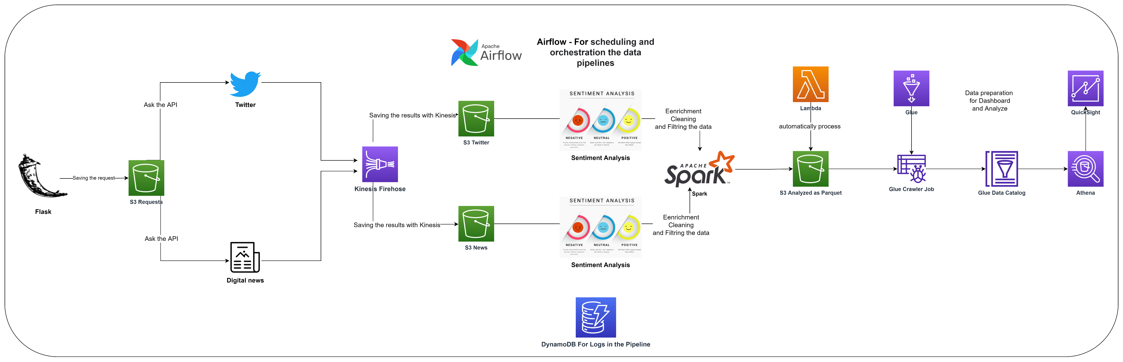
Solution architecture

Slide 6
AWS Cloud platform
AWS as the cloud platform.
GCP only for a local machine
AWS Pros:
Automated functionalities like scaling , setup, and others.
Cost-effective service that allows you to pay only for what you use, without any up-front or long-term commitments.
Much more automatic Services.
Large community to consult with.
AWS Cons:
Some services might be expensive.

Slide 7
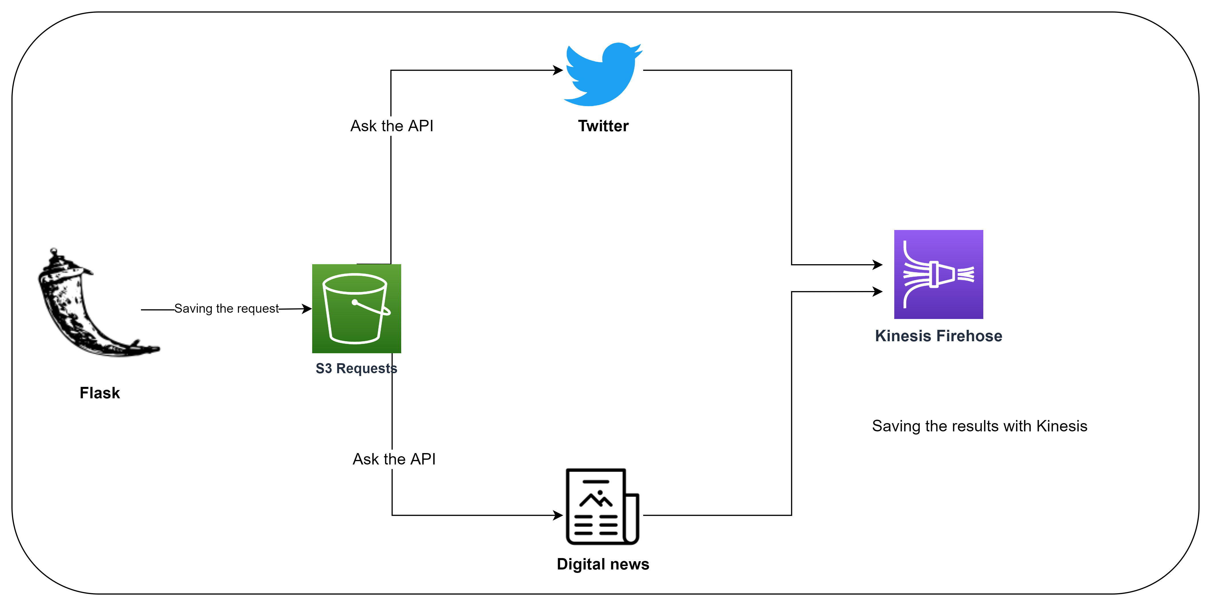
Part 1 – Getting the Raw Data

Slide 8
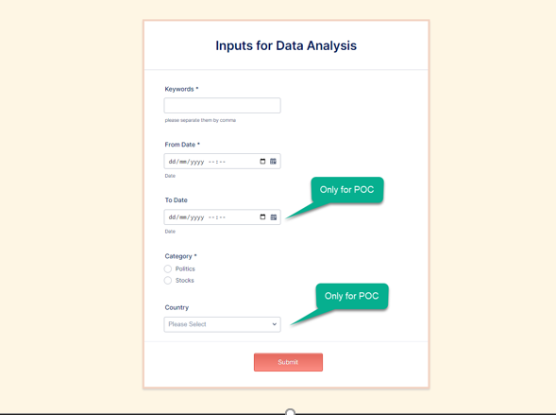
User Input Form – To Know What to Search
We provides a sort convenient form for the end user
Advantages of using Flask are (There is a built-in development server and a fast debugger provided , Lightweight )

Slide 9
S3 - Main storage
We decide to choose the S3 as our main storage for all the solutions
Connect with all other AWS Services.
Easy to insert new data (insert and less time from table)or create new folder
No need to mange a RDBS properties like PK , constrains and much more
Easy to analyze with the Athena services .
Each request saves in different folder, so the querying is much faster
Data can be saved as json or parquet
No need do make join or update data in the flow

Slide 10


Data Sources
Twitter – Via Tweepy package which provide convent way to access the Twitter APIs
News.io API – Provide News from the digital media like ‘The Sun’ ,and the ‘National Post’

Slide 11
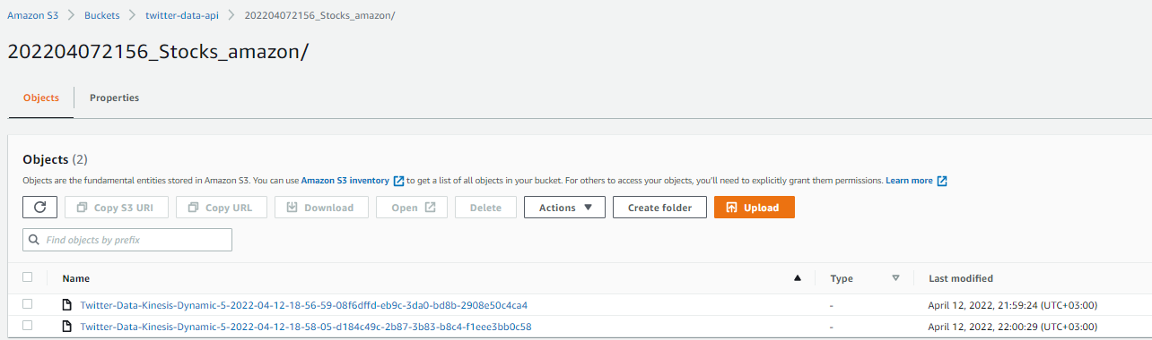
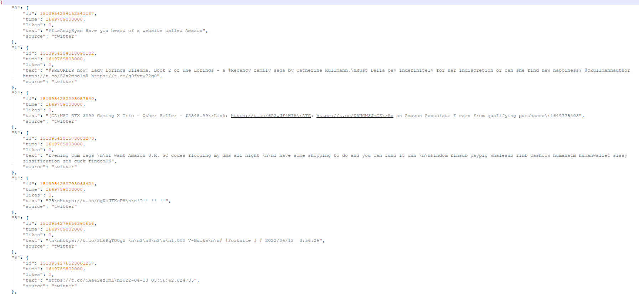
Twitter – Data Example
Data from Twitter sored in S3 as json files

Slide 12
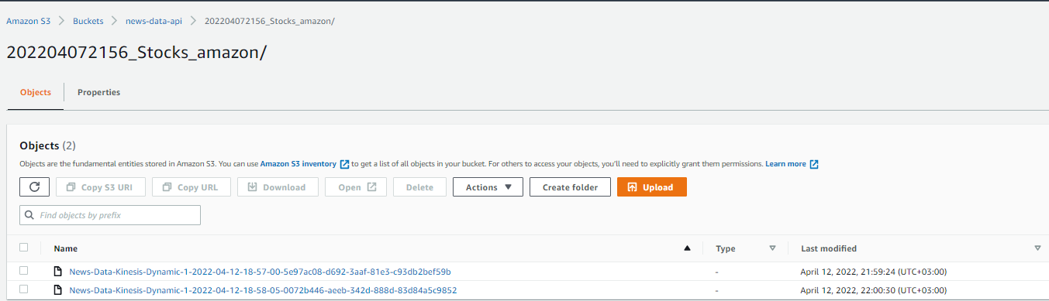
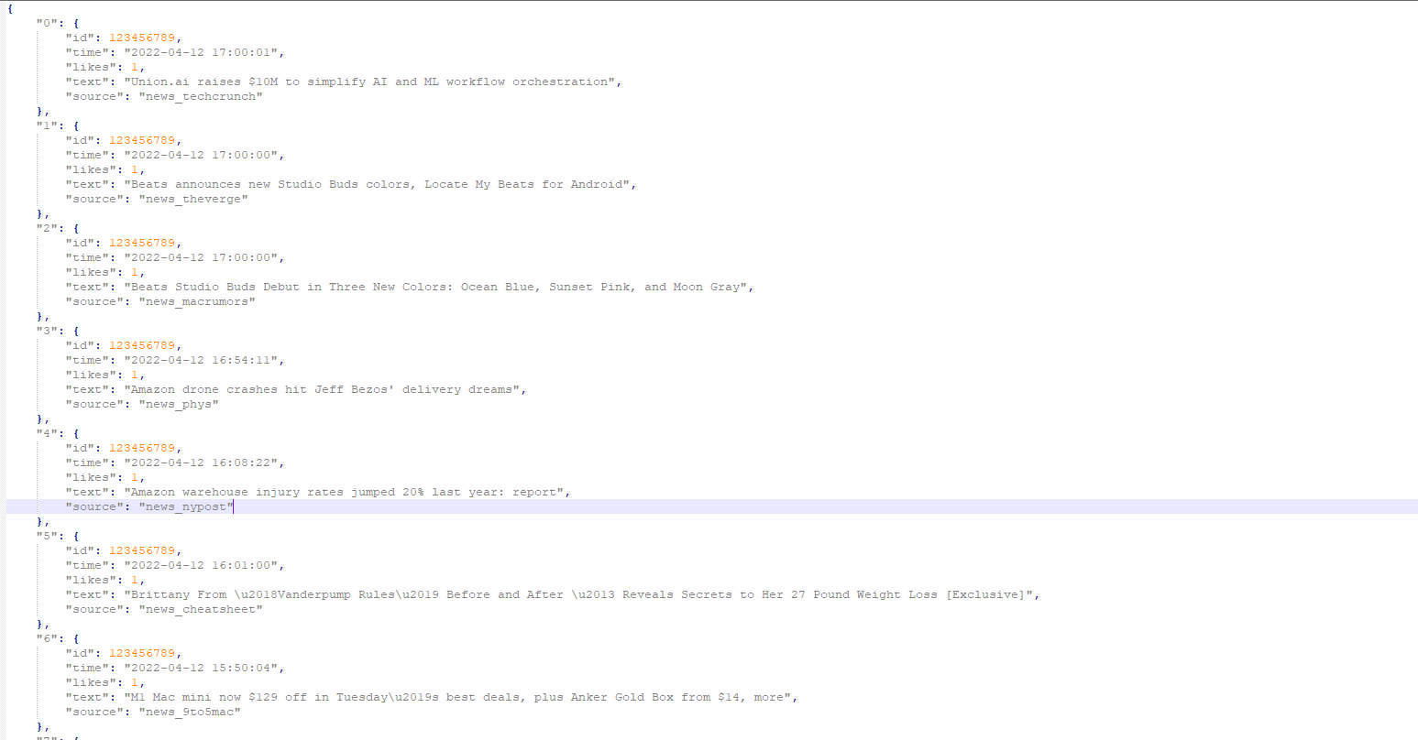
News.io – Data Example
Data from News.io also sored in S3 as json files

Slide 13
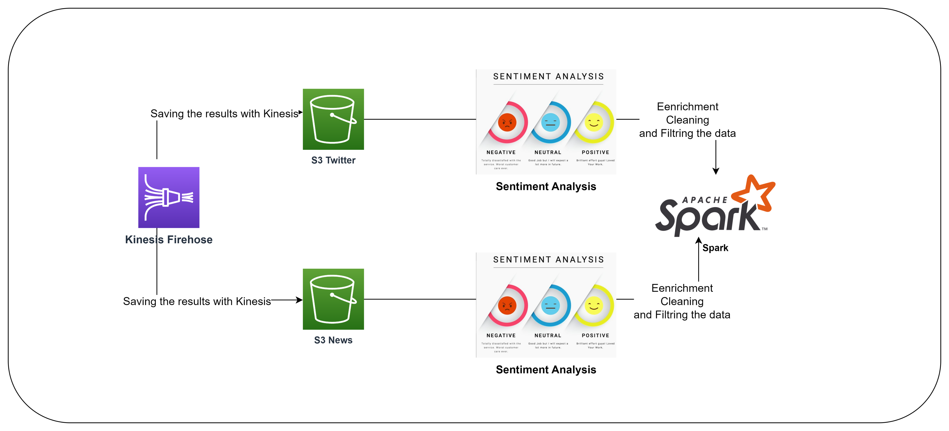
Part 2 - Structured Zone

Slide 14
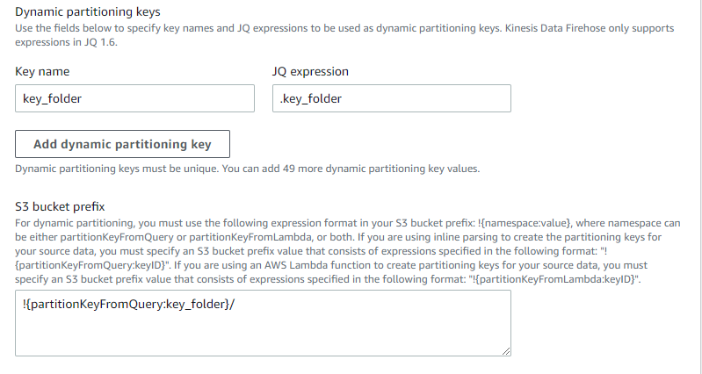
Kinesis - Streaming services
Kinesis is a managed service (SaaS) of AWS , Kinesis simplifies the process of introducing streaming technology for those who don’t have their own resources to manage Kafka
AWS takes care of provisioning, deployment, on-going maintenance of hardware, and software of the Kinesis.
Creating a dynamic partition to store each request in a different folder
Most of the cons are not relevant in this project (like Maximum 7-day storage or less flexibility).

Slide 15
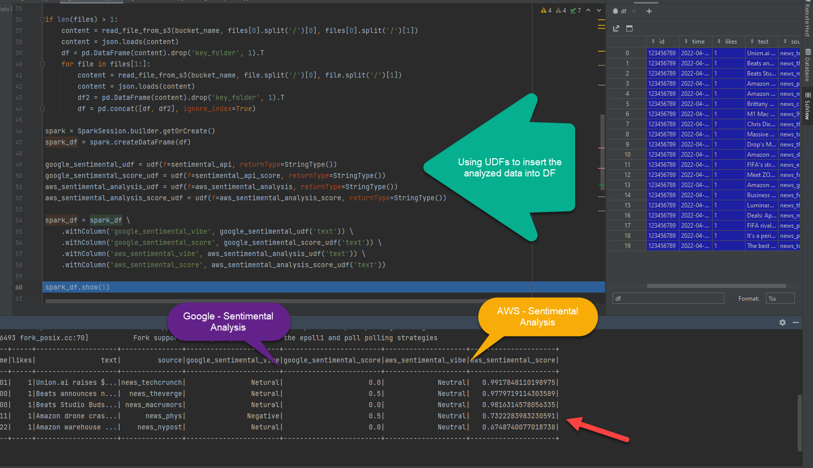
Analyze texts with AWS & Google Sentimental
Both Google and Amazon offers API to analyze texts. Script go through the new files from Twitter and News.io, cleansing the text, and analyze the data with the Sentimental APIs > Convert into Spark Data Frame

Slide 16
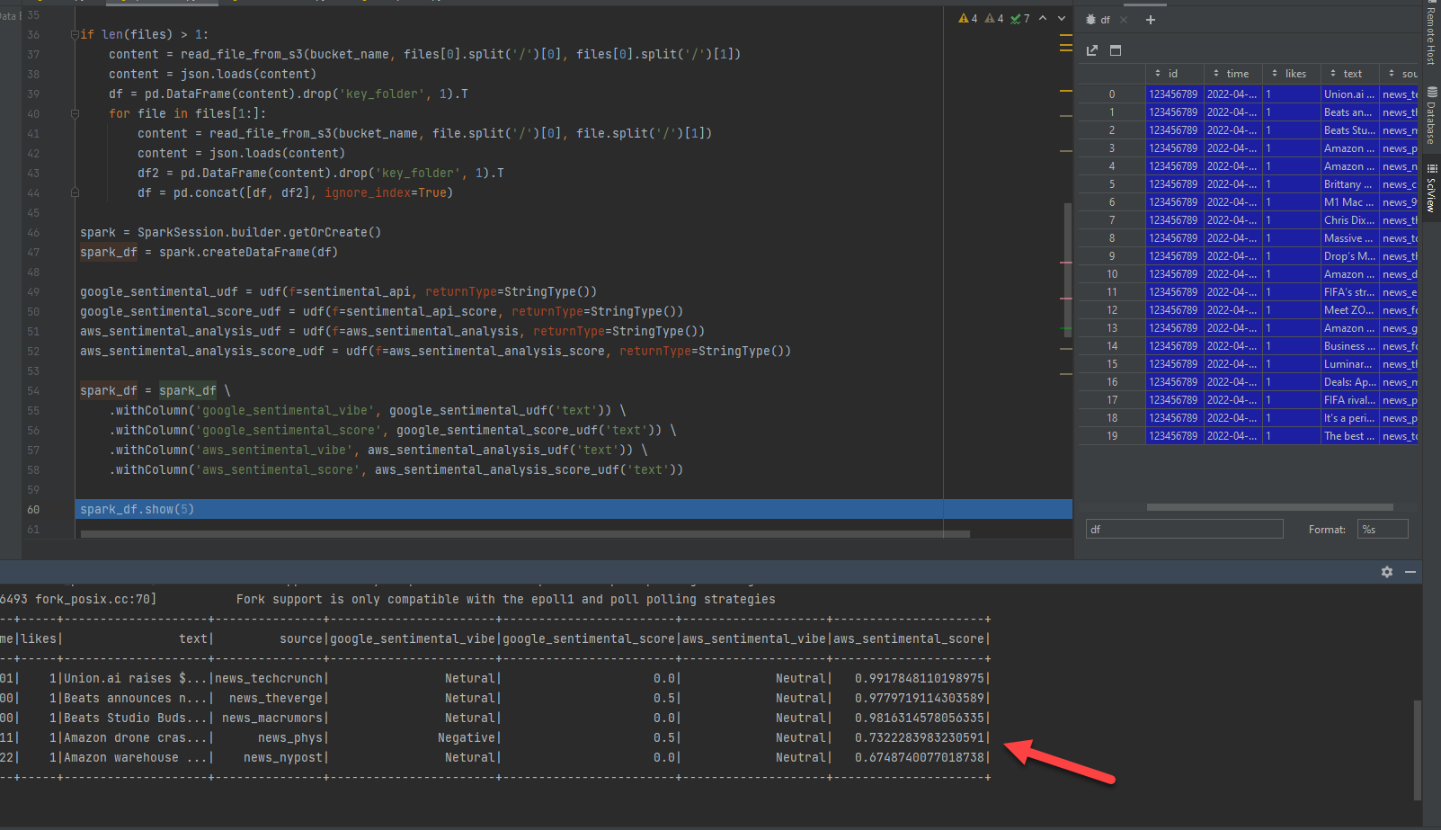
Analyzed Data - Convert into Spark DF

Slide 17
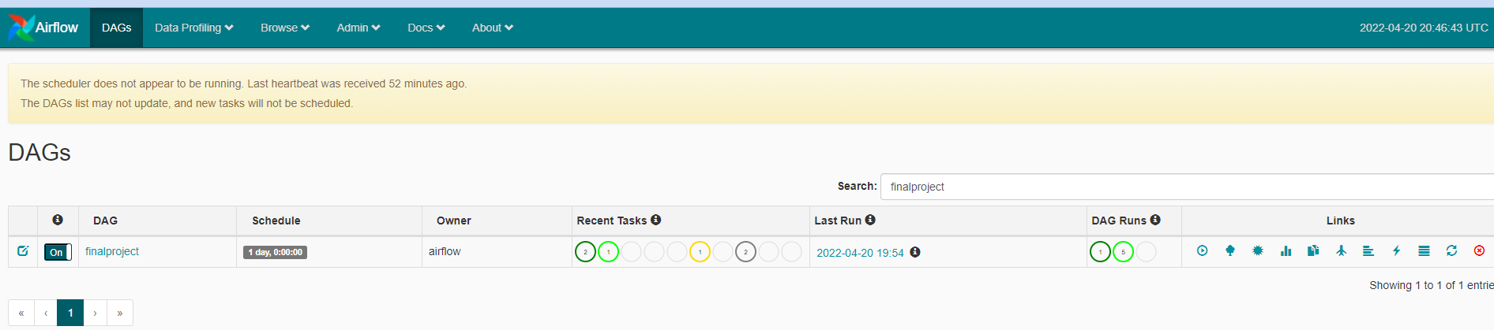
Airflow- orchestration
The pipeline launched by the Airflow.
Although the AWS is our main platform, we are using Airflow since our machine is in the google cloud (GCP).

Slide 18
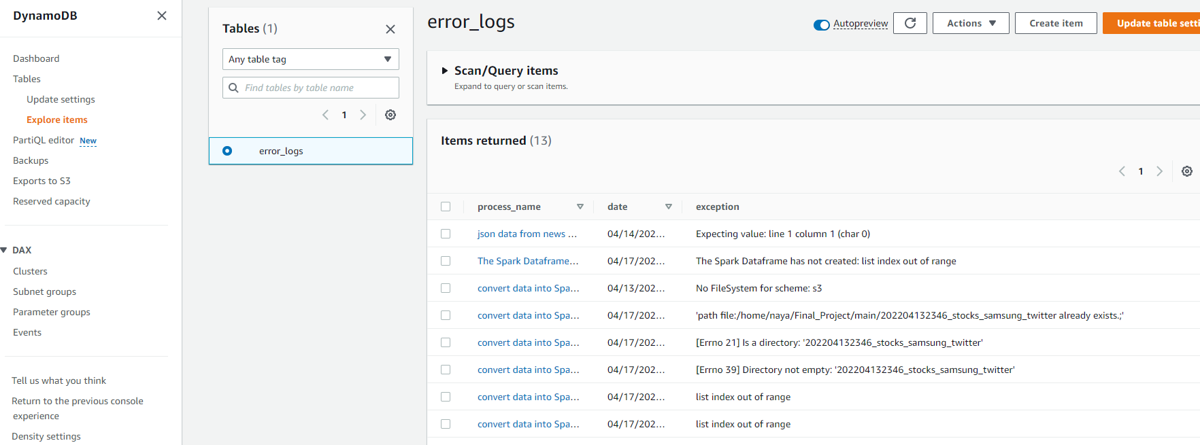
DynamoDB – Log DB
We used a DynamoDB to store all the logs in the Pipeline
Its SaaS of AWS and its good for key-value or simple queries are present
Connect very easy with the boto3 lib

Slide 19
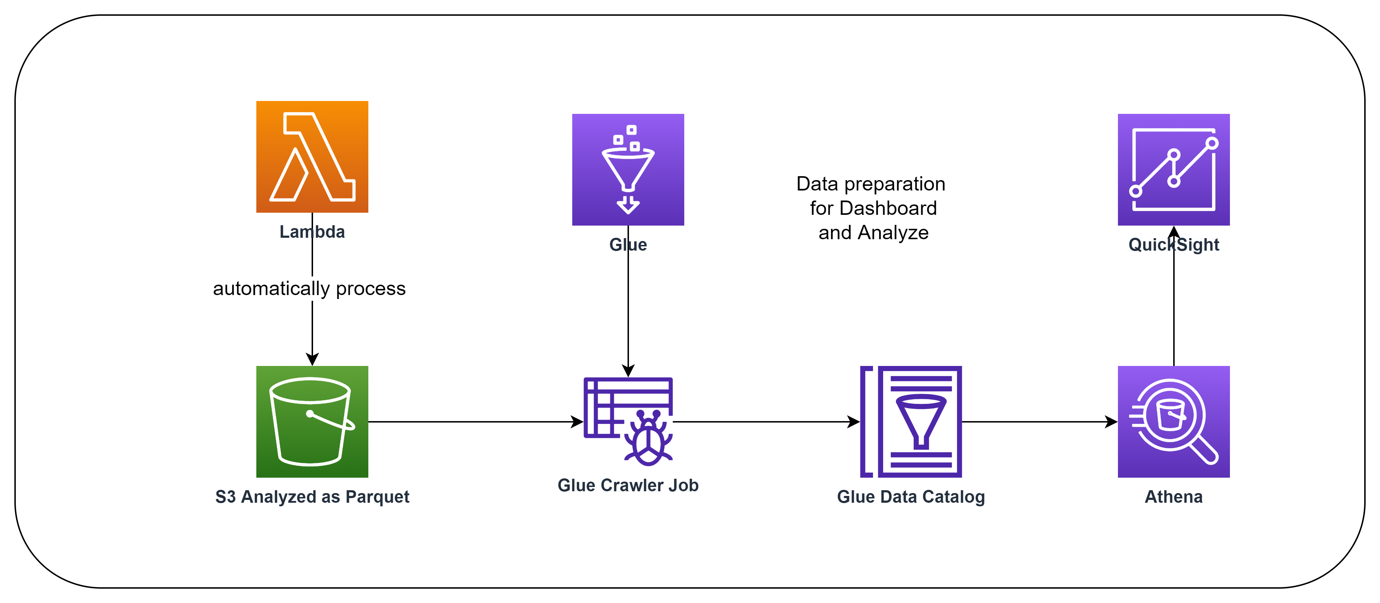
Part 3 – Consumer & Analytics Zone

Slide 20
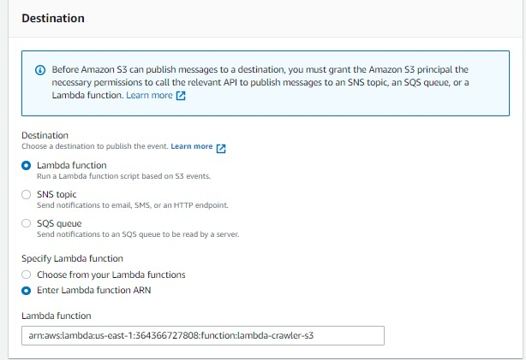
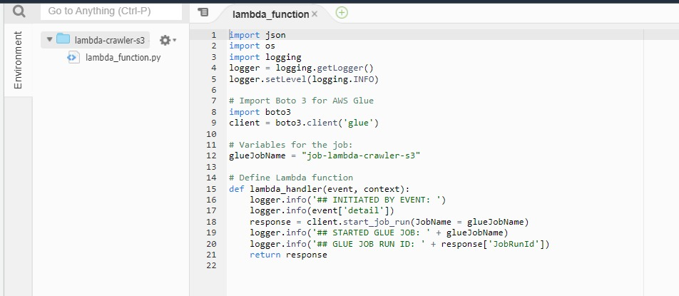
Event Rules - Lambda
An event notification on the Reports S3 bucket.
This event trigger a Lambda function every time it identifies a changes in the bucket.
Advantages of lambda : Minimized Cost ($0.20 per 1M requests) , Automatic Scalability and Less Operational Management

Slide 21
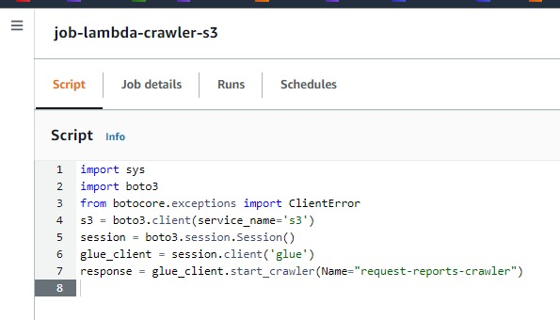
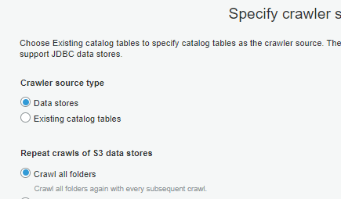
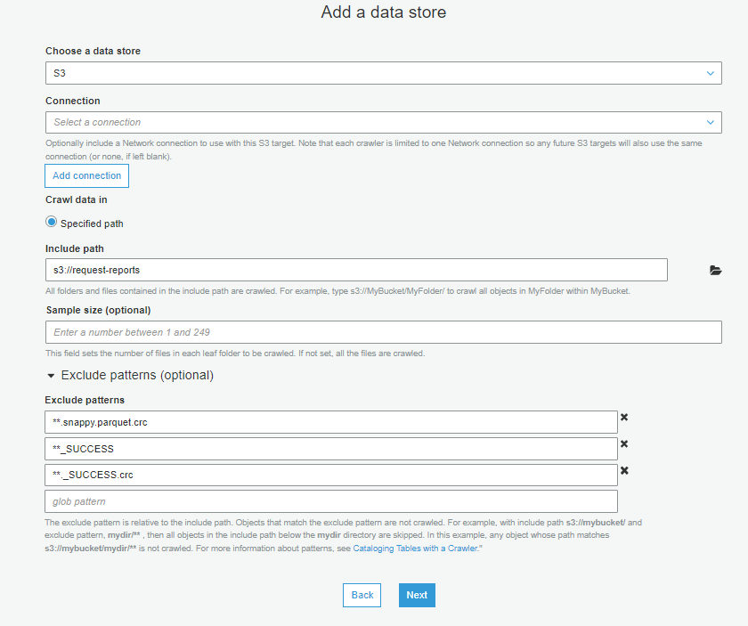
Aws Glue (Job, Crawler and Data Catalog)
The lambda function trigger a Glue job.
In the Glue job initiate a Crawler that identify the changes in the S3 Bucket which store all the Results from the user input and update the Glue Data Catalog
After the Crawler finish , the Catalog stores metadata for tables (like their schema and location) and partitions in a relational database.
The process above finally provides client access to this information by using Athena

Slide 22
Athena - Querying and analyze data
Provides serverless data querying which is stored in Amazon S3 with the help of standard SQL
Provides support to various data formats like structured, semi-structured and unstructured
Quicker and easier to execute the queries on Amazon S3 without taking care of the server and the cluster to set up or manage

Slide 23
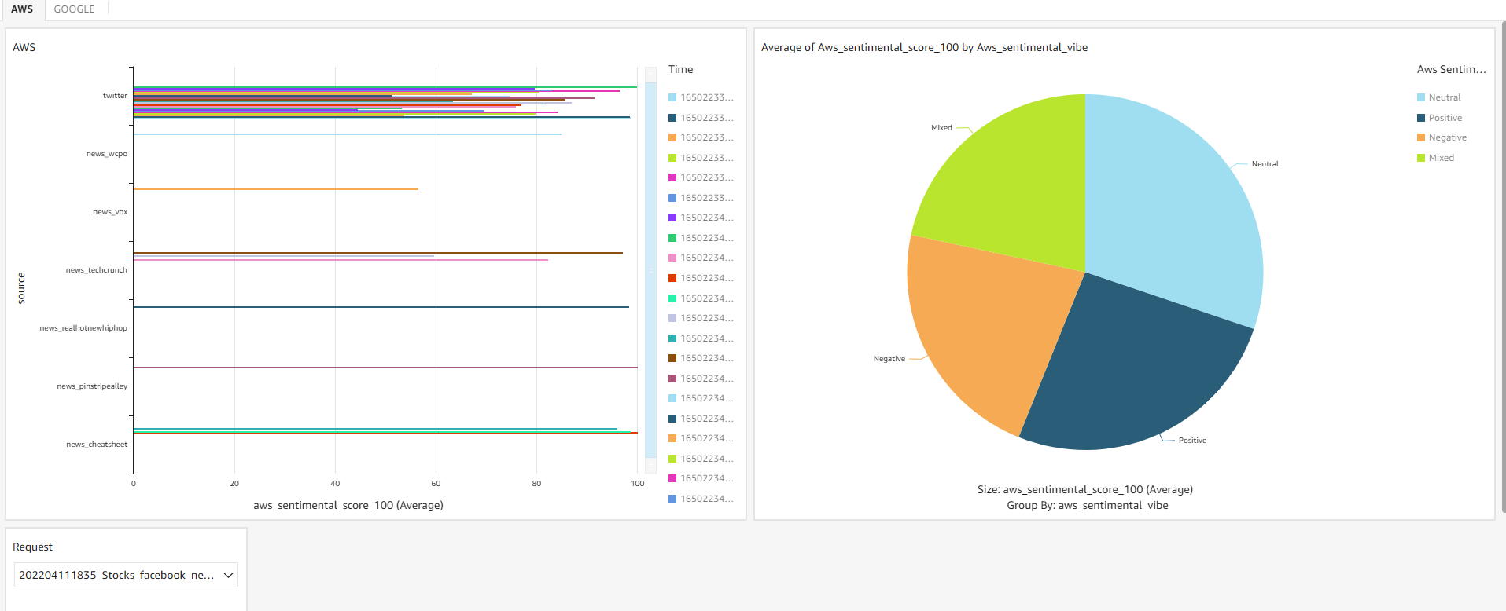
QuickSight - Dashboards
QuickSight can access data from many different sources like Athena, S3 and DynmoDB
Fast Calculation on the Fly
AWS SaaS

